Slide 1
Tic-Tac-Toe Simulator
Carter Riley and Rudyjay Keopuhiwa

Slide 2
Goals
Create a GUI based application to play Tic-Tac-Toe and several variants
User control of what variant they want to play
Display the rules of each variant
Settings menu where users can change the background and font color
Allow saving game and loading of game from text file

Slide 3
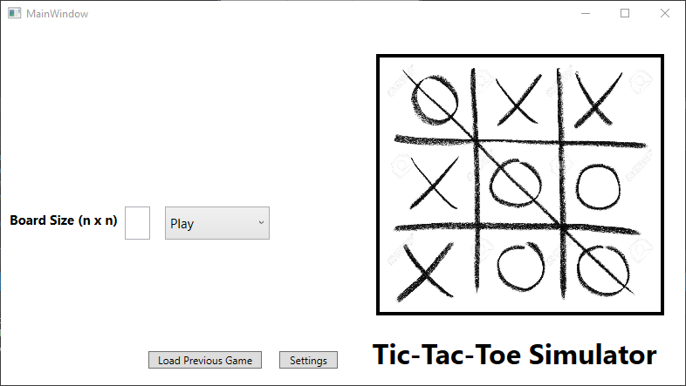
Tic-Tac-Toe and several variants
Designed Tic-Tic-Toe using WPF and XAML designer
Select and play 9 different variants
Normal
Ultimate
3D, etc.
Uses multiple windows

Slide 4
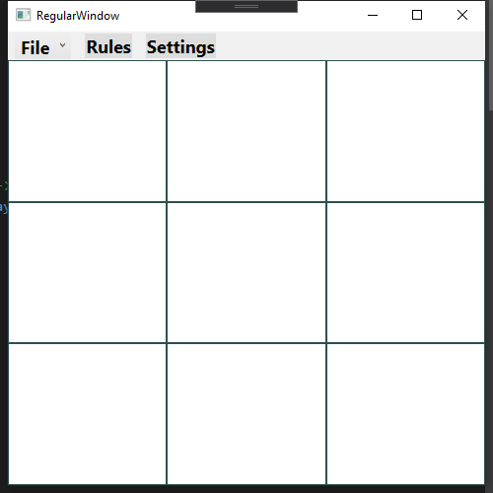
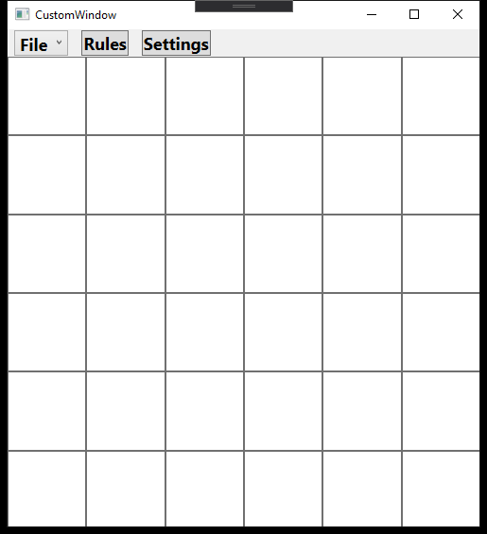
Use of different Windows
Regular Window
Displays a regular 3 x 3 board
Base for all game modes
Custom Window
Displays a n x n board based on user input
We wanted it to keep all custom board logistics distinct from the regular board
Ultimate and 3D Tic-Tac-Toe
They both have their own separate window because their game boards and logistics are eccentric to a regular Tic-Tac-Toe game

Slide 5
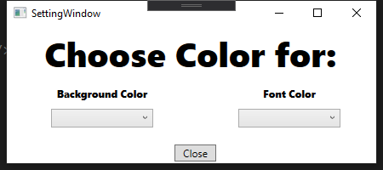
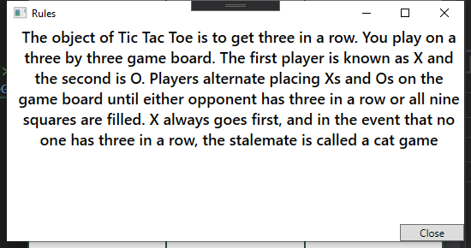
Use of different Windows
Main Window
Main Menu
User chooses variant and board size
Setting Window
Change colors of background and font
Rules Window
Display rules depending on variant type user has chosen

Slide 6
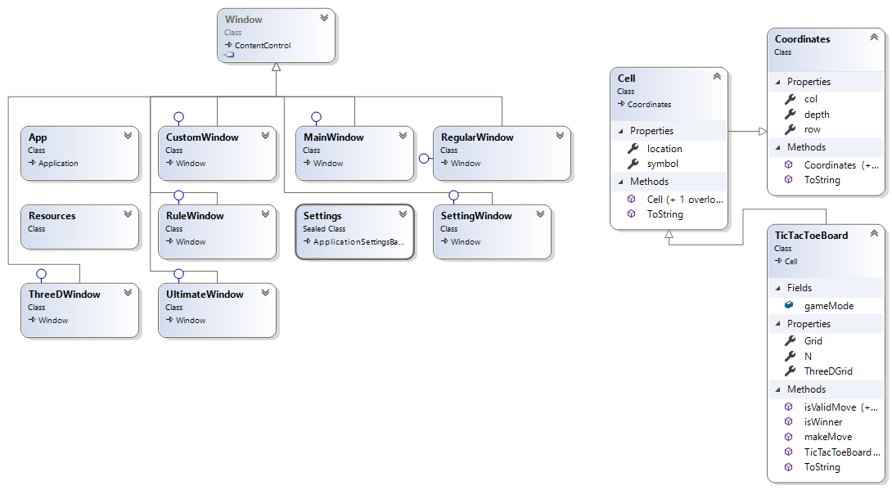
Logistics
An overarching TicTacToeBoard Class that was used in every variant
TicTacToeBoard was derived from Cell and my thinking was that each cell would have a piece (X,O) and a Coordinate which would consist of two or three ints
I chose to design it this way because it was easily expandable as we made more variants of Tic-Tac-Toe

Slide 7
Problems
WPF
Creating a dynamic window
Used for custom size boards
Accessing the entire brush library for settings menu
Having colors remain constant across all windows
Logistics

Slide 8
Future Ideas
Implement online games across a network
Implement single player play
User vs Computer
Create a mobile app version

Slide 9
Questions or Comments?

